Slide 1
Heat Transfer (CH21204)
Conduction and Radiation
Class –VII and VIII
Design of Heat Exchangers
Heat Transfer from Extended Surface

Slide 3
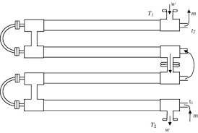
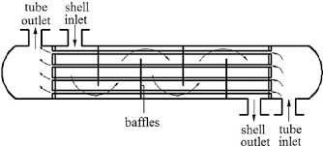
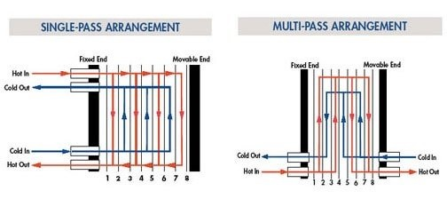
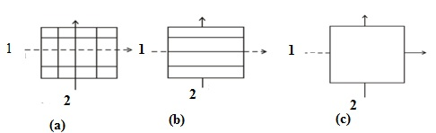
Double Pipe heat exchanger
Shell and tube heat exchanger
Plate type heat exchanger

Slide 4
Design of Heat Exchangers
Overall Heat Transfer Coefficient
Fluid B

Slide 6
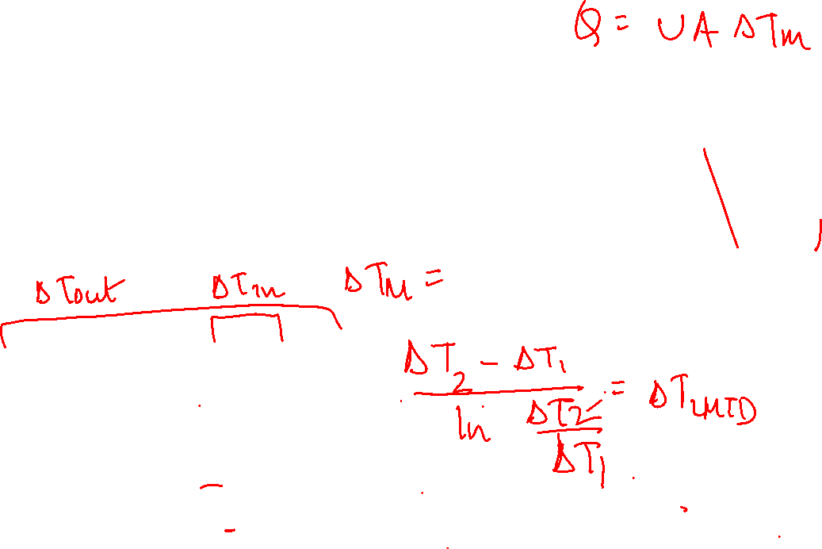
Design of Heat Exchangers
Log Mean Temperature Difference

Slide 7
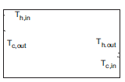
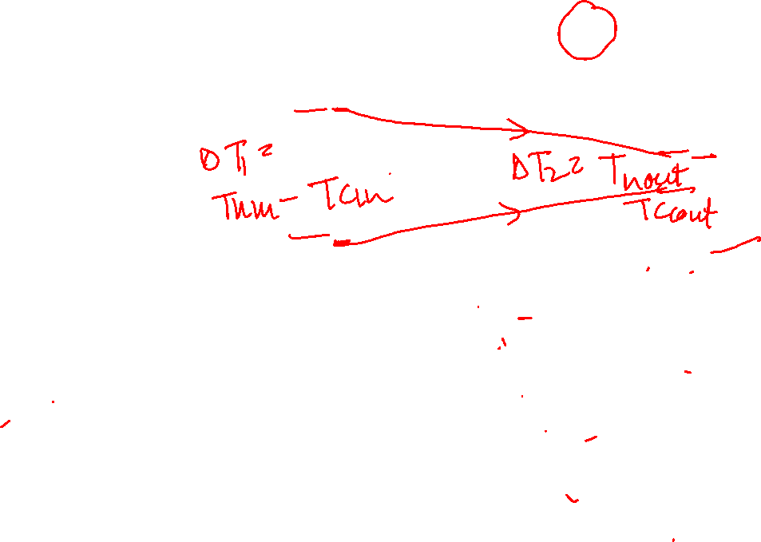
Design of Heat Exchangers
Overall heat Transfer Coefficient
T
Fluid B
T
Axial Distance

Slide 8
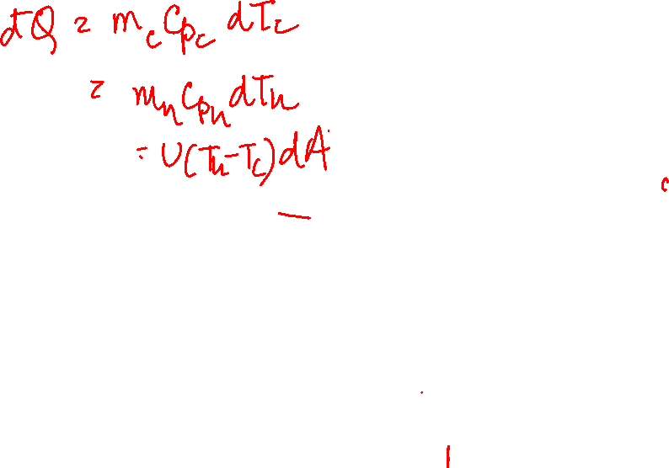
Parallel Flow Exchanger
Log Mean Temperature Difference
Assumptions –
Heat exchanger insulated such that heat exchange between hot and cold fluid only
Axial conduction along tubes negligible
(One dimensional heat conduction along radial direction)
Negligible changes in potential and kinetic energy
Fluid specific heat constant
Overall heat transfer coefficient constant

Slide 9

Counter Flow Heat Exchanger
Log Mean Temperature Difference

Slide 10
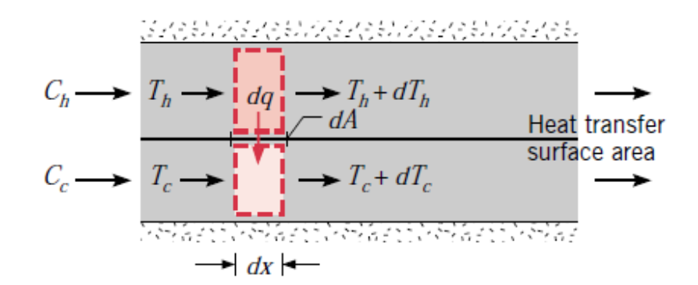
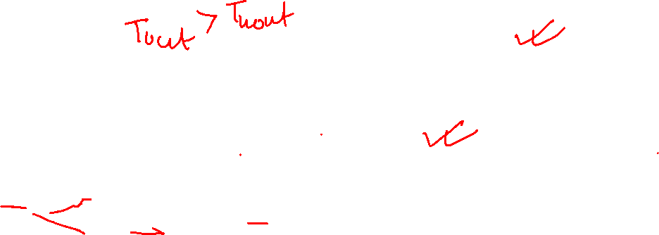
Log Mean Temperature Difference

Slide 11
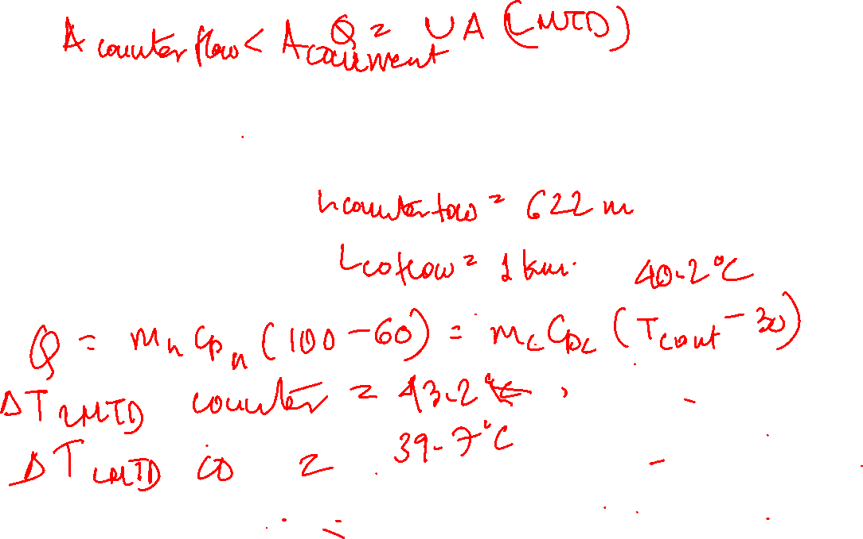
Example Problem:
Lubricating oil is to be cooled from 100⁰C to 60⁰C by using cooling water available at 30⁰C.
A counter flow concentric heat exchanger is used for this purpose.
Cooling water is introduced through the inner tube (Di =25 mm) at a flow rate of 0.2 kg/s and flow rate of lubricating oil through the annulus (D0 = 45 mm) is 0.1 kg/s. Estimate the tube length required for the cooing duty
Given: hi = 2250 W/m²(K) and ho = 38.8 W/m²(K). The specific heats of oil and water are 2131 J/kg(K) and 4178 J/kg(K) respectively.
Repeat the problem for a parallel flow concentric heat exchanger

Slide 12
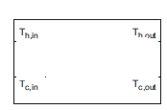
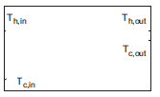

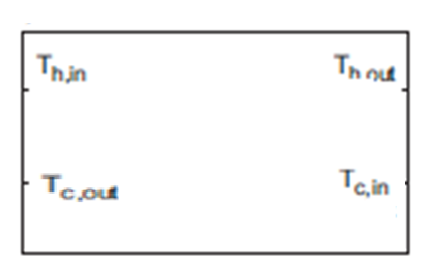
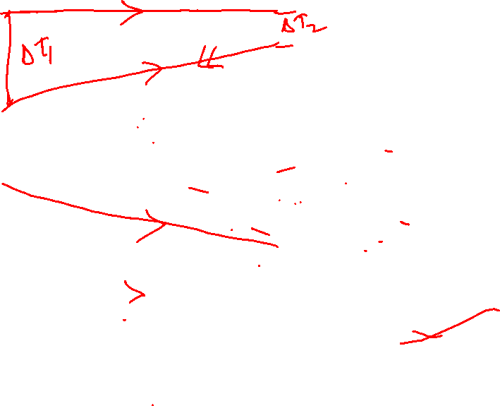
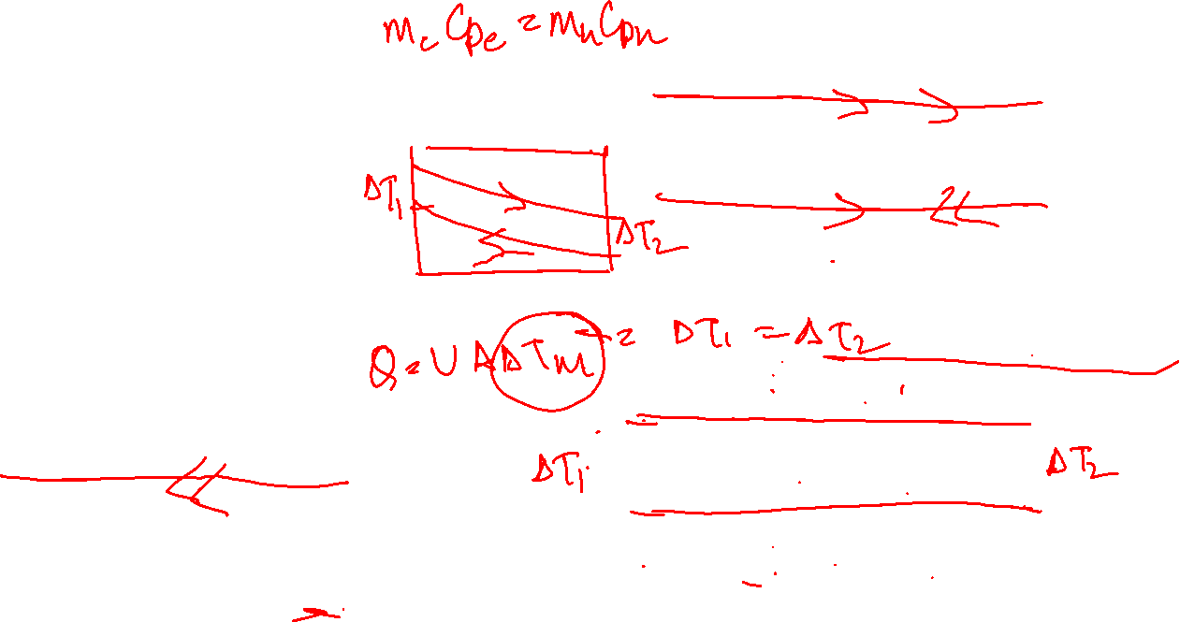
One Fluid Changing Phase
Both Fluids Changing Phase
Counterflow exchanger with
for ΔT1 = 0 or ΔT2 = 0

Slide 13

Example Problem:
Lubricating oil is to be cooled from 80⁰C to 60⁰C by using cooling water available at 30⁰C. A counterflow concentric heat exchanger is used for this purpose.
Cooling water is introduced through the inner tube (Di =25 mm) at a flow rate of 0.2 kg/s and flow rate of lubricating oil through the annulus (D0 = 45 mm) is 0.1 kg/s. Estimate the tube length required for the cooing duty. Given: hi = 2250 W/m²(K) and ho = 38.8 W/m²(K). The specific heats of oil and water are 2131 J/kg(K) and 4178 J/kg(K) respectively.

Slide 14
Design of Heat Exchangers
Assumptions of LMTD concept
Fluid specific heats do not vary with temperature
No phase change
Convection heat transfer coefficients are constant throughout the exchanger

Slide 15
If physical properties and overall heat transfer coefficient (U) vary and/or fluid temperature profile is not smooth along the tube length, a simple and (conservative) practice is to evaluate the heat transfer coefficients at the stream inlet and outlet temperatures and use the lower of the two values.
Alternatively
If the variation in physical property over the temperature range is too large, the entire heat exchange length is divided into a number of small lengths Δz and the basic heat transfer equation(s) are applied to each length element and the results are summed up, viz.
j is the j^{th} element and ΔT_{LMTD,j} is the log mean temperature difference in the j^{th} element.

Slide 16
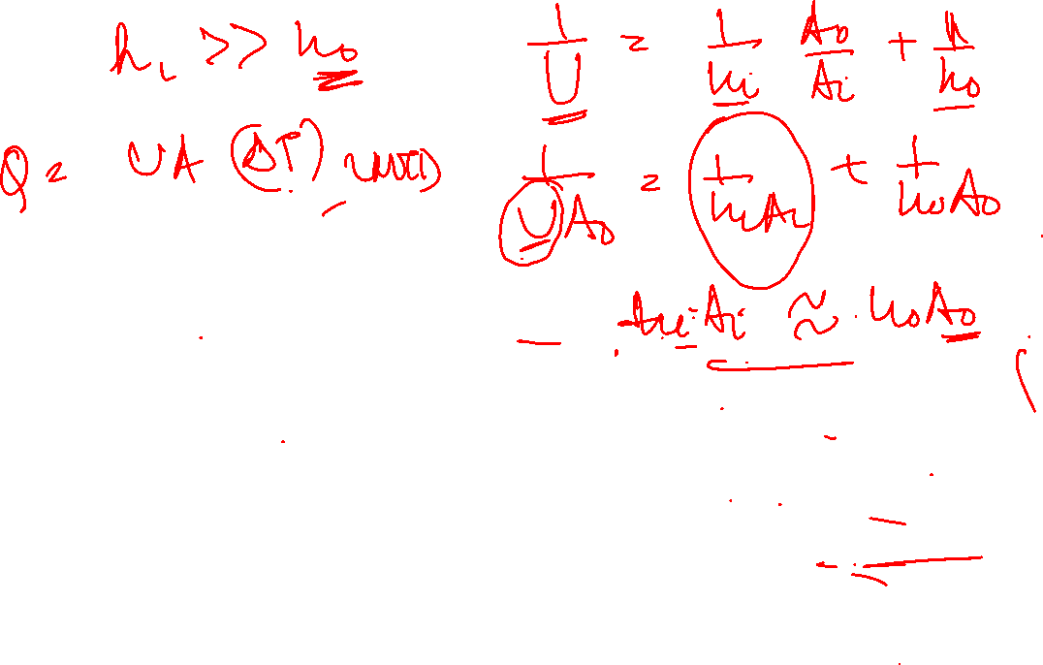
Fins

Slide 17
Types of Finned surfaces
Straight fin of rectangular profile
on plane wall
Straight fin of rectangular profile
on circular tube
Cylindrical tube with radial fin of rectangular profile
Cylindrical spine / circular-rod fin

Slide 18
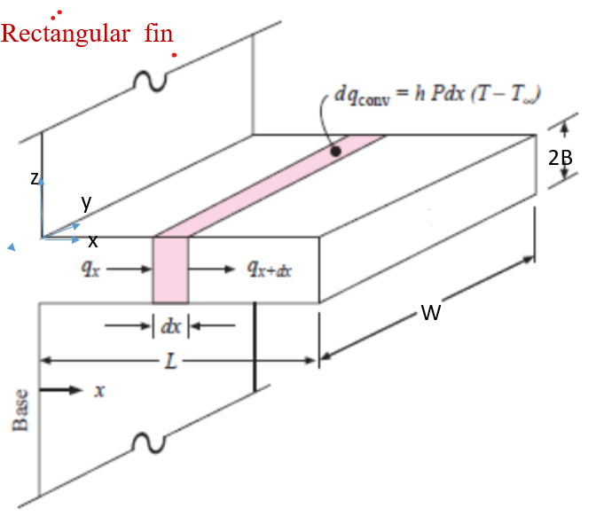

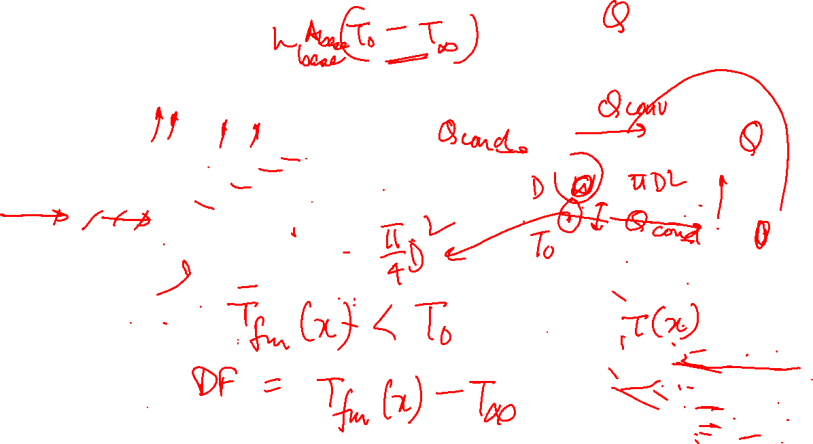




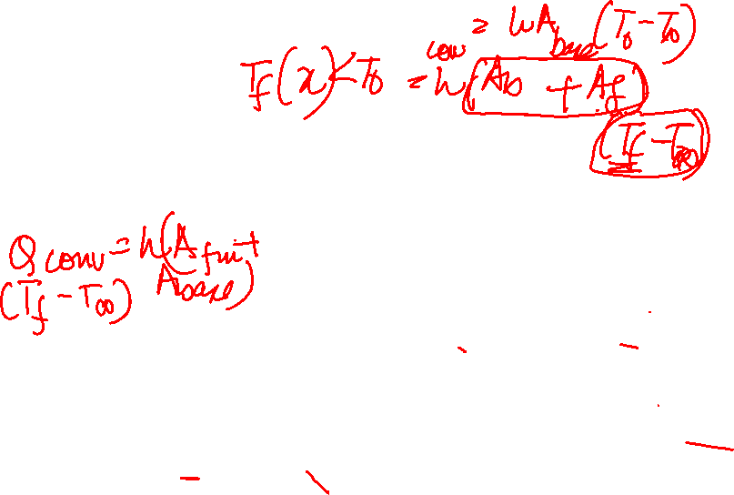






Conduction-Convection Systems

Slide 19
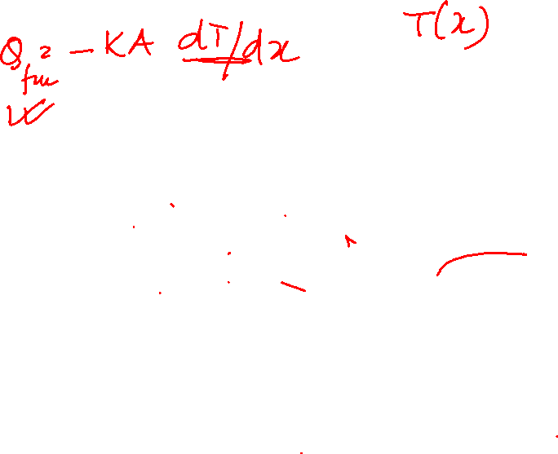
Conduction-Convection Systems
Actual Situation | Model
1. T = T( x , z) but dependence on z is more pronounced | T =T(z)
2. A small quantity of heat is lost from the fin at the end area (area 2BW) and the edges (area 2BL + 2BL) | No heat is lost from the end or the edges
3. h = h(x) | Heat flux at the surface = q = h(T-T_{a}) where h = constant and T = T(x)

Slide 20

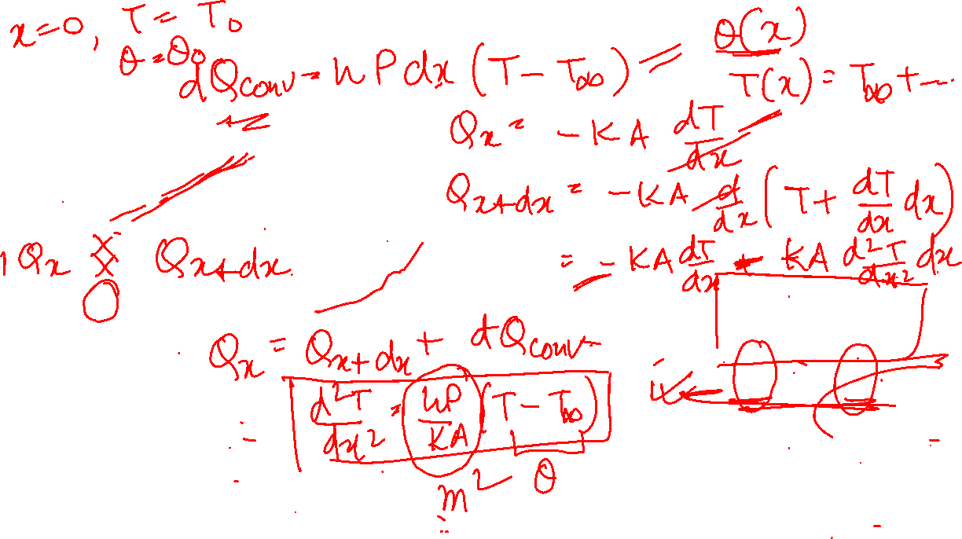
Conduction-Convection Systems
t
z
y
x
W
B.C.1: At x = 0, T =T0, θ = θ0
B.C.2 depends on physical situation

Slide 21

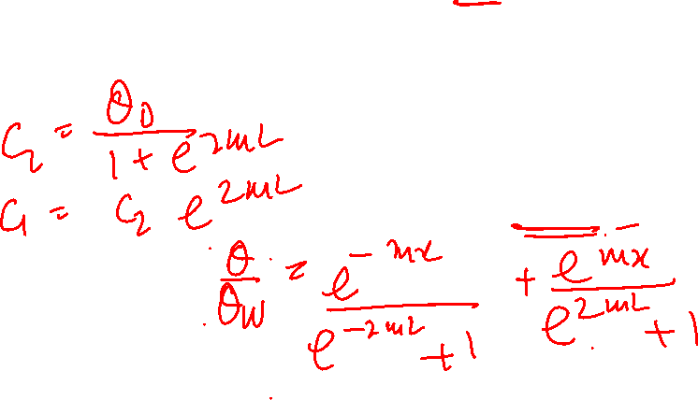
Conduction-Convection Systems
Case II
t
z
y
x
B.C.1: At x = 0, T =T0, θ = θ0
Z
B.C.2: End of fin is insulated, i.e.

Slide 22
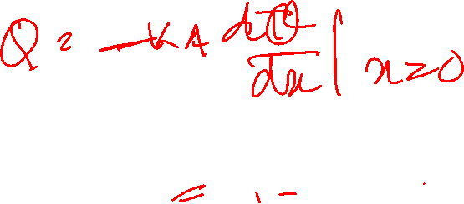
Conduction-Convection Systems
Case II
2B
z
y
B.C.1: At x = 0, T =T0, θ = θ0
x
B.C.2: End of fin is insulated, i.e.
W

Slide 23
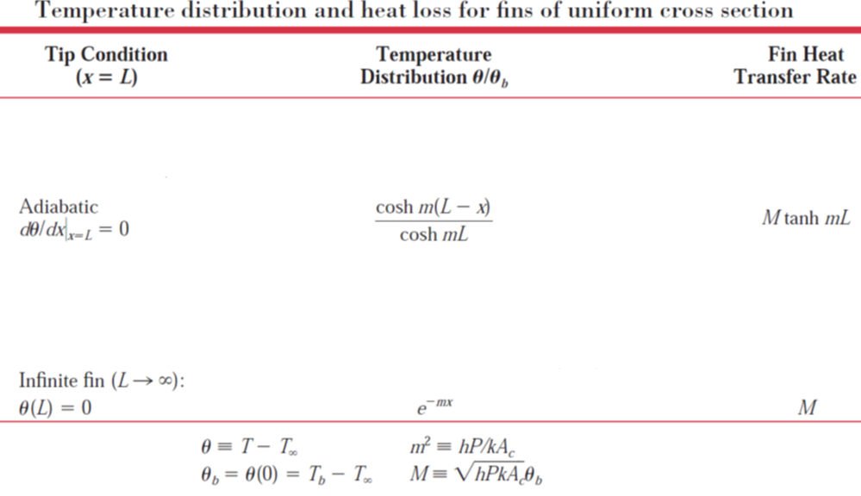
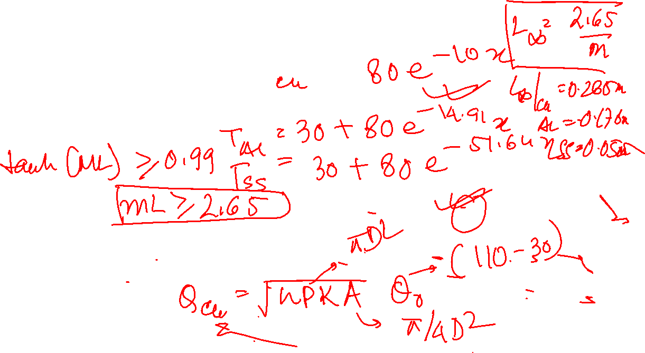



Slide 25



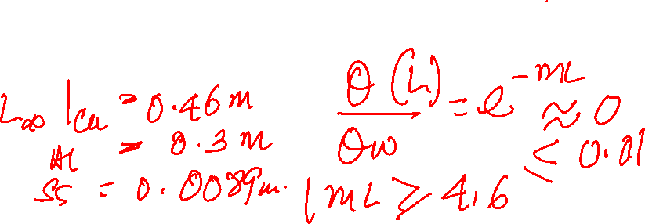
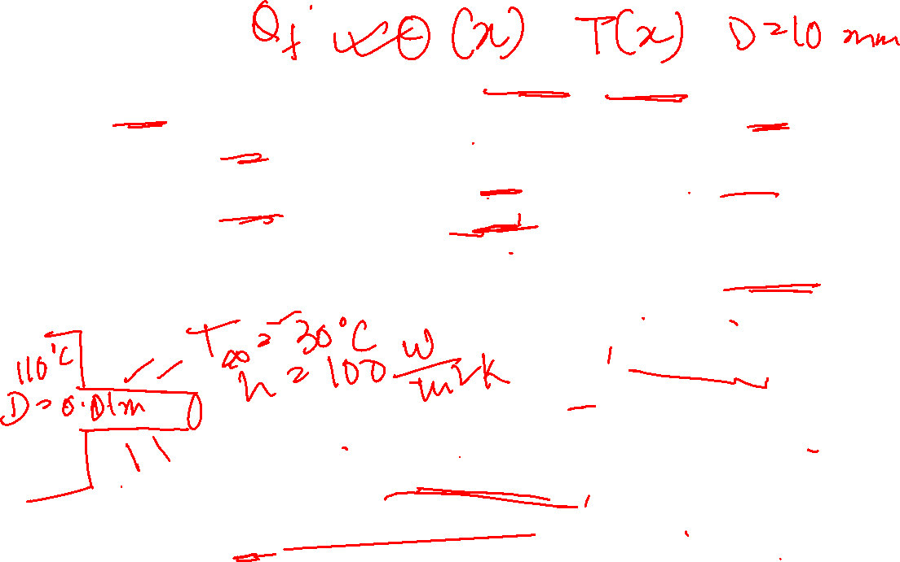

Example Problem:
Estimate the temperature distribution along a very long rod 10 mm in diameter whose one end is maintained at 110⁰C and the surface of the rod is exposed to ambient air at 30⁰C (convection heat transfer coefficient =100 W/m²(K).
The material of the rod is (a) pure copper ( k= 400W/m.K)(b) 2024 aluminum alloy (k= 180W/m.K) © stainless steel (15W/m.K).
(ii) Also estimate the corresponding rates of heat loss from the rod
(iii) Estimate the minimum length of the rod in each case for assumption of infinite length to yield an accurate estimate of the rate of heat loss

Slide 26
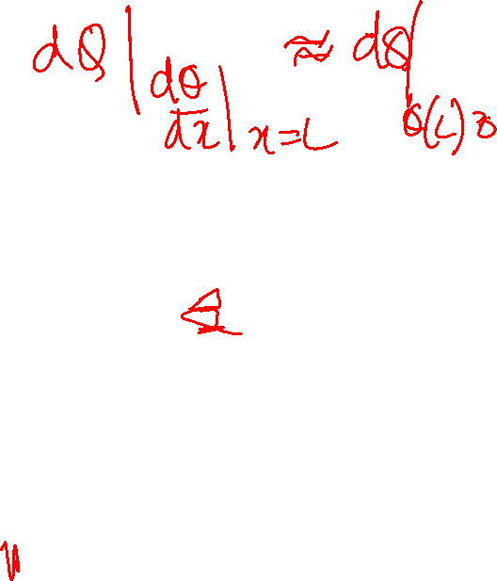

Slide 27
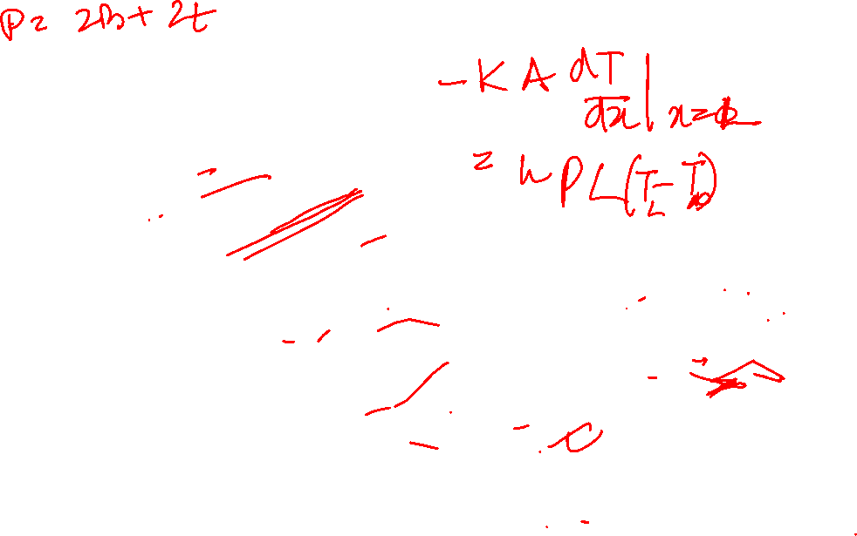
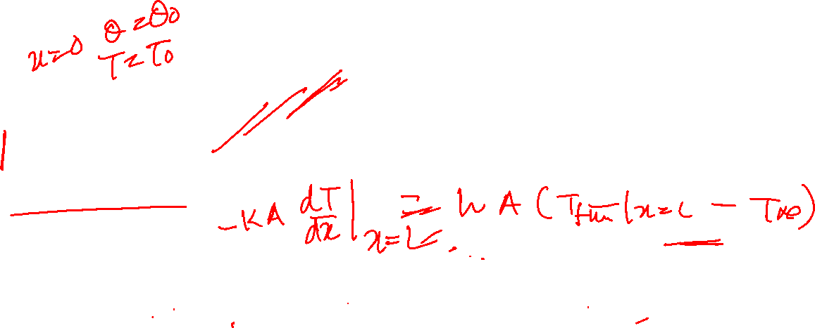
Conduction-Convection Systems
Case III
t
z
y
x
Z
B.C.1: At x = 0, T =T0, θ = θ0
B.C.2: Fin is of finite length and loses heat by convection from its end

Slide 28
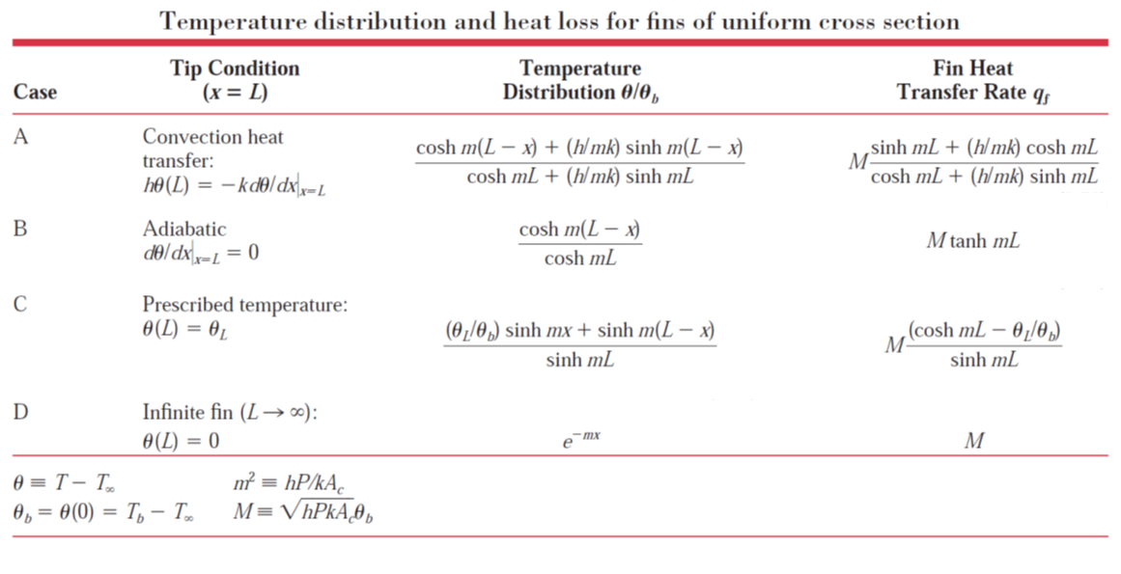
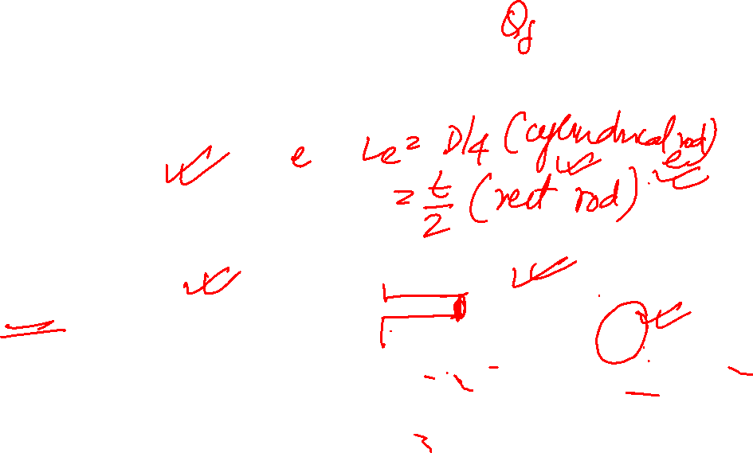

Slide 29
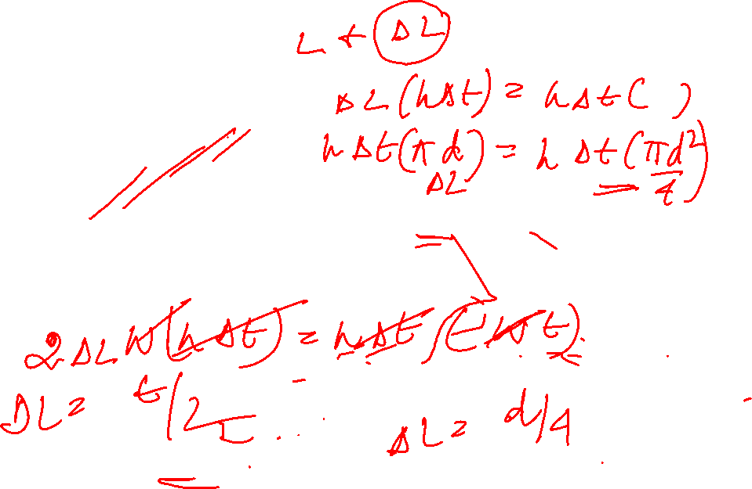

Conduction-Convection Systems
t
z
y
x
Assumptions
Fin/rod protruding from wall is of uniform
cross-section
h uniform over entire surface
Substantial temperature difference only in x direction
Z

Slide 30


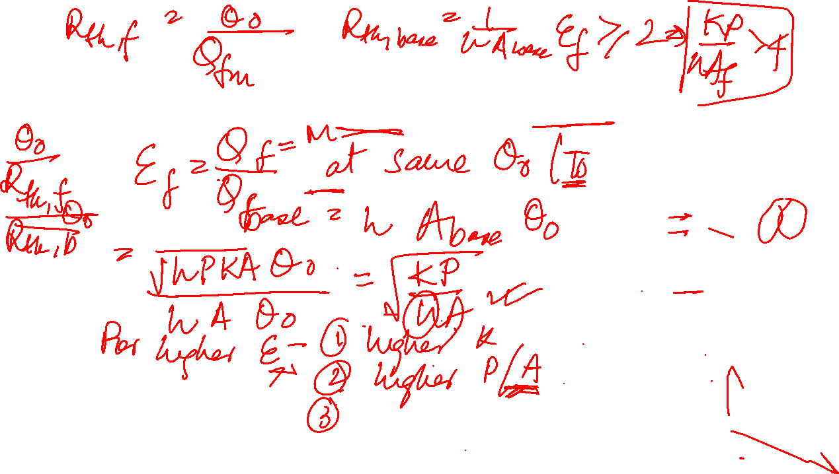
Fin performance Parameters
Fin Effectiveness = (Actual heat transferred with fin)/(Heat transferred without fin )
Fin Thermal Resistance

Slide 33
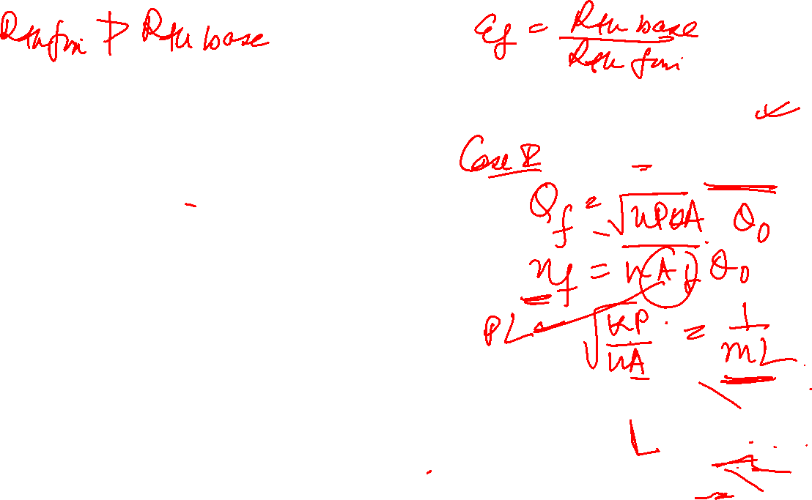
Fin Efficiency
ⴄ_{f} = (Actual heat transfer)/(Maximum possible heat transfer
t
z
When entire fin at base temperature,T0
y
x
Z
Case I

Slide 34
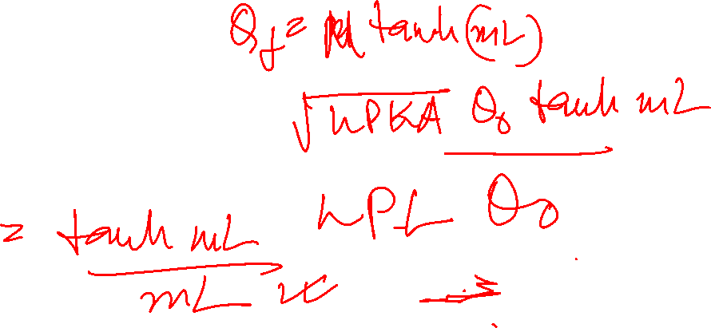
Fin Efficiency
ⴄ_{f} = (Actual heat transferred)/(Heat which would be transferred if entire fin at base temperature, T0 )
t
z
y
x
Z
Case II

Slide 35
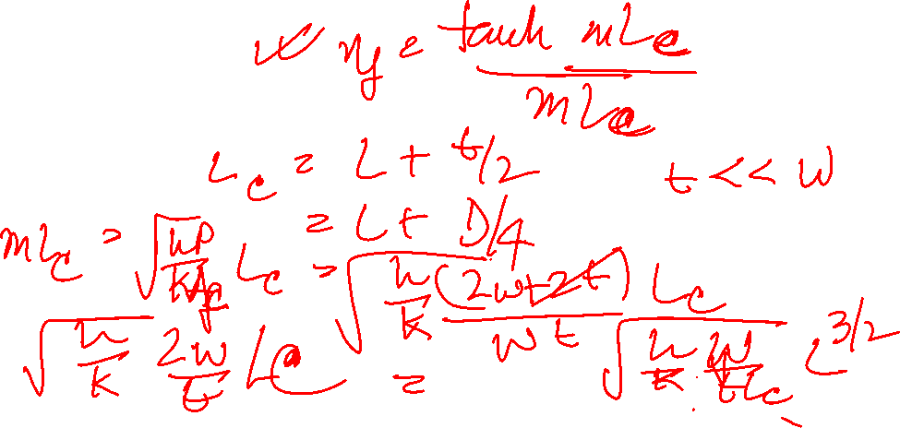
Fin Efficiency
ⴄ_{f} = (Actual heat transferred)/(Heat which would be transferred if entire fin at base temperature, T0 )
t
z
y
x
Z
Case III

Slide 36
Efficiency of straight rectangular and triangular fins
Efficiency of circumferential fin of rectangular profile

Slide 37
Overall Surface Efficiency

Slide 38
Overall Surface Efficiency

Slide 39
Example Problem
The engine cylinder of a motor cycle constructed of Aluminium alloy is of height 150 mm ad outer diameter 50 mm. 10 equally spaced annular fins, each of 6 mm thickness and 20 mm length, are integrally cast with the cylinder to reduce the temperature. For a heat transfer of 3 kW from cylinder to ambient at 300K (h = 75 W/m²(K)), estimate the reduction in cylinder temperature by use of fins.

Slide 40
Conditions when fins do not help
Compare the heat transfer with and without fin for a SS pin fin (k =16W/m.K), L = 10 cm, d = 1 cm which is exposed to boiling water (h= 5000 W/m²(K).

